Slide 1

How many times has this happened to you?

Slide 2
You know what you want to do
Get fit?
Learn a language?
Get a better job?

Slide 3
You start a new behavior
Going to the gym
Using a new app
Applying to jobs

Slide 4
A week later, you've forgotten
Why you started
What you wanted the end result to be
Any progress you've made along the way

Slide 5

Maybe you need to
measure.

Slide 6


MEASURE
The Secret to Language Learning
Boom Languages v5.0

Slide 7
This Talk
The Problem – Language Learning Struggles
The Solution – What I want to build
The Plan – How I'll execute

Slide 8
The Problem

Slide 9




We’ve got it all
Apps galore
Hundreds of hours of TV and movies
Penpals on demand
But people still struggle to learn a new language.
What’s missing??

Slide 10

Nothing
It’s all there! We have all the tools we need to learn a language
Many have taught themselves using free tools on internet
But there’s a problem

Slide 11
No integrated solution.
Language learning is hard – too hard for one tool to solve it all.
It's not one skill – it's hundreds, working together like an orchestra.
To get good, you need to try a lot of different things.

Slide 12
Even if you think you know what you need to do, it's too common to:
Plateau and not know what to do next
Feel like you don't know how good you are
Get good at one skill but neglect all others
(great at reading/writing, can't speak)

Slide 13
What's the fix?
Let's ask Peter Drucker.

Slide 14

"What gets measured gets managed."
Peter Drucker

Slide 15
Wait a second...
That's not the full quote

Slide 16
"What gets measured gets managed — even when it's pointless to measure and manage it, and even if it harms the purpose of the organization to do so."
Peter Drucker
Notes:
Src: https://static.store.tax.thomsonreuters.com/static/relatedresource/CMJ--15-01%20sample-article.pdf

Slide 17

So we need...
something that measures/rewards
the RIGHT things
for a language learner

Slide 18
The Solution

Slide 19
MEASURE Your Language Learning with Boom
PAST
Logging what you've done so you can feel good about it later
PRESENT
Telling you where you're at and where you're going
FUTURE
Setting goals that feel achievable and actionable

Slide 20

Past: Logging
Make your language learning history visible – and beautiful
Timeline view of what you've done
EASY – just a few clicks to log your Duo session
Log anything, but encourage using Boom's specialized tools

Slide 21



Present: Status
Streak: how many days in a row
Stats: Cumulative activity for each, estimated skill level
Reading, writing, speaking, listening

Slide 22
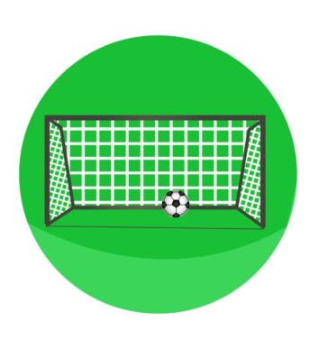
Future: Goals
Which skill area?
Reading/speaking/listening/writing
How do you know you're done?
I can hold a convo for N minutes
What do you have to do to get there? (COMMIT)
Work on skill X for Y min/day
When ready, set up a call by N

Slide 23
Minimum Viable Product
What's the smallest number of features that can make this useful?
User accounts
Login/logout/register
Logging
Can add activity, select skill area/category, add note – Activity CRUD
Current
Show current streak & count for each skill area – Dashboard
Future
Can add a goal, describe end state, specify subtasks – Goal CRUD

Slide 24
The Plan
Making It Real

Slide 25

Monetization Strategy
Core measurement features: Free
Premium features (3 types):
Monthly Boom subscription = unlimited access to all Premium Features
One-time purchase to buy unlimited access to ONE feature
One-time purchase to buy unlimited access to ALL features (+ future ones?)

Slide 26
Action Plan
1. Build MVP.
2. Find customers.
3. Get feedback & re-assess.

Slide 27

Action Plan: Phase 1
Start October 19, Launch November 19
Milestones
Week 1 (10/26): Account features complete
Week 2 (11/2): PAST features complete
Week 3 (11/9): PRESENT features complete
Week 4 (11/16): FUTURE features complete
Task breakdown / tracking: ClickUp
When complete: Find first batch of testers (people who NEED to learn a language)
Post weekly update to PageKey YouTube

Slide 28
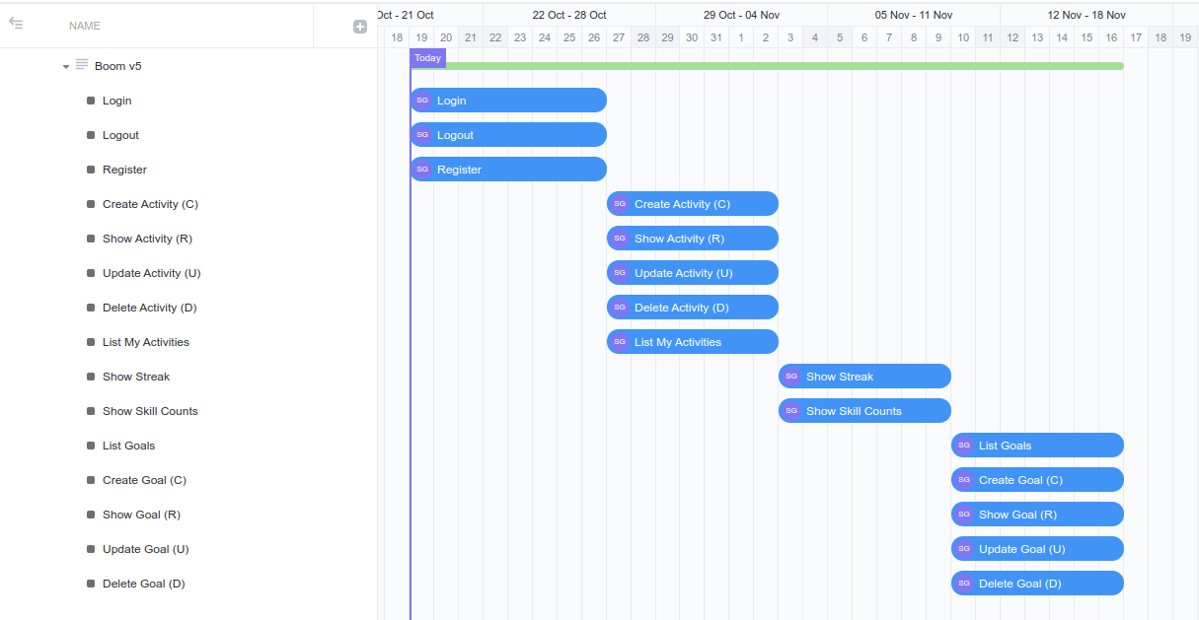
Action Plan: Phase 1

Slide 29

Weekly Status
Demo
Paste Gantt chart
Challenges
Successes
Lessons Learned

Slide 30

Long Term Plan
October:
Develop core features
Nov-Dec:
Find 5 test users, get feedback on core features
Add first Premium Feature
Add purchasing (buy buttons)
2024Q1:
Find users, improve product, repeat
Goal: 100 daily active users by 3/31/2024
Goal: 10 premium users by 3/31/2024

Slide 31
Sacrifices
Goodbye, tech tutorials.
Goodbye, other side projects (for now)
PKOS
Plaintext DAW
Many other ideas I have been wanting to work on
Goodbye, YouTube subscribers who only wanted tech tutorials
New use for channel – accountability, not education
Build in public – share lessons learned

Slide 32

See you next week.
by 10/29 at the latest.

Slide 33
Thank you.
MEASURE - The Secret to Language Learning
Boom Languages v5.0

Slide 34
Speaking of measurement...
Key Performance Indicators for Boom:
# of user accounts
# of daily active users
# of active subscriptions
# of feature purchases

